Slide 1
Context, mission and service
James Munro, CEO, Care Opinion CIC

Slide 2
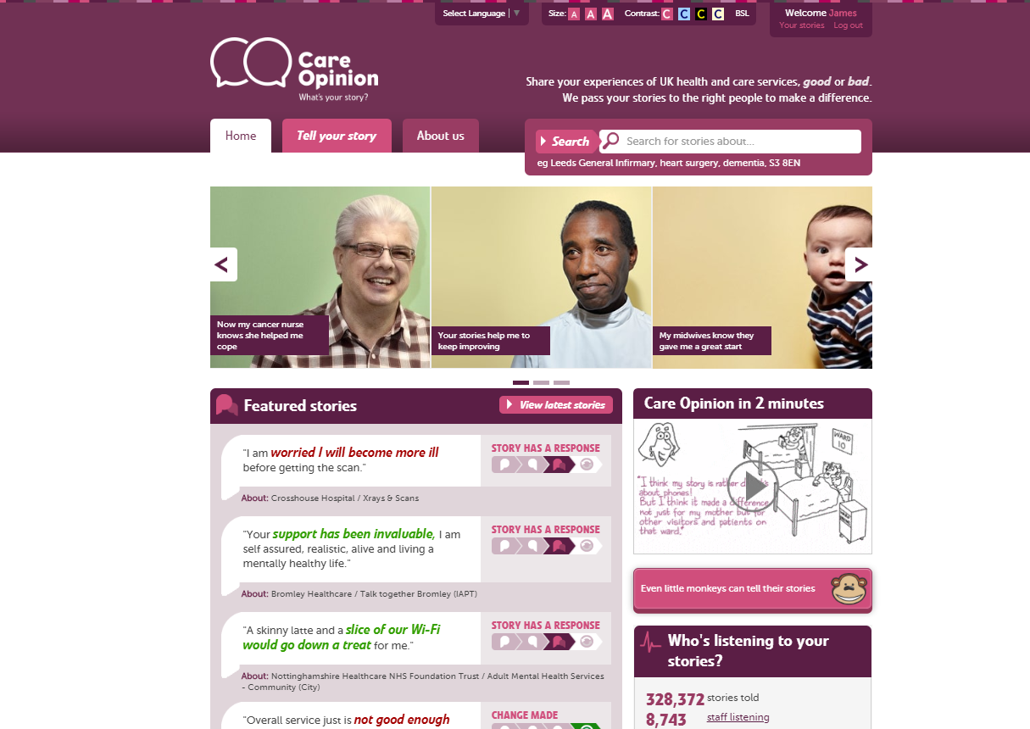

Slide 3
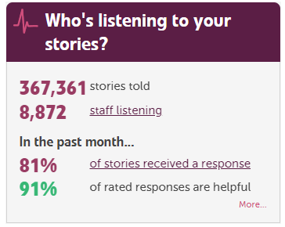

Slide 4
Vision
We want people to be able to share their experiences of health and care in ways which are safe, simple, and lead to learning and change.

Slide 5
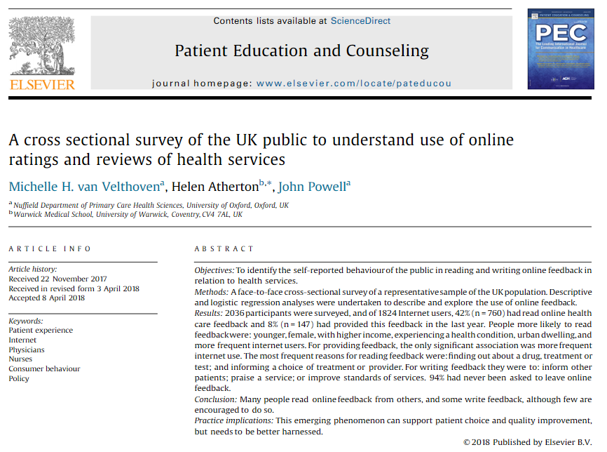
In the past year, 42% of people have read online feedback about healthcare

Slide 6
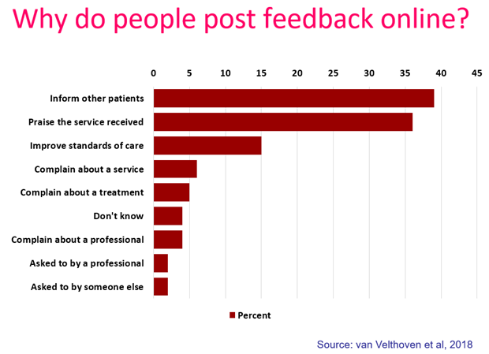

Slide 7
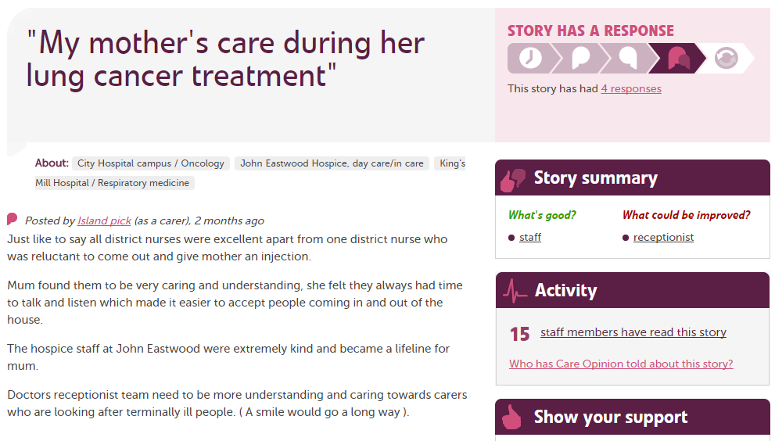

Slide 8
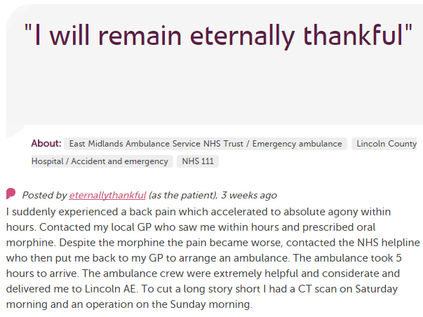
In each provider
Moderation
Clinical staff
Porters, reception, catering…
Pt exp, comms, complaints…
Alerting
CEO
Commissioners
Nursing, AHP students
Healthwatch
Researchers
Patient groups
CQC
Local authority

Slide 9
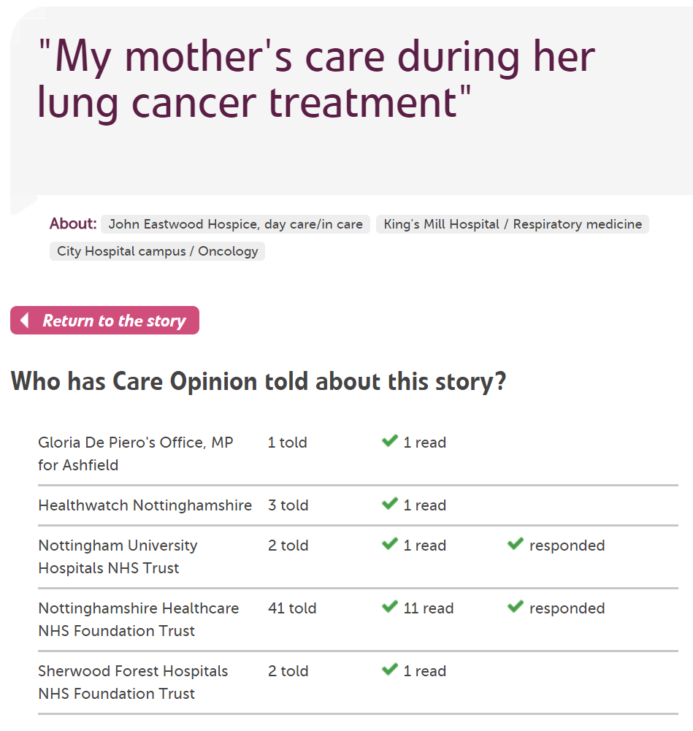

Slide 10
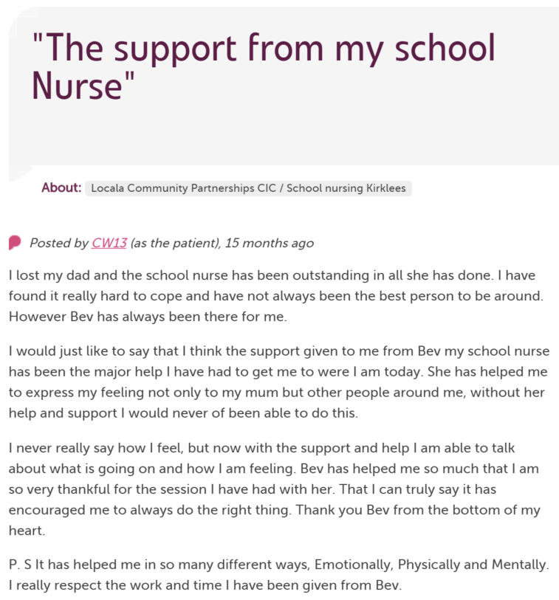

Slide 11
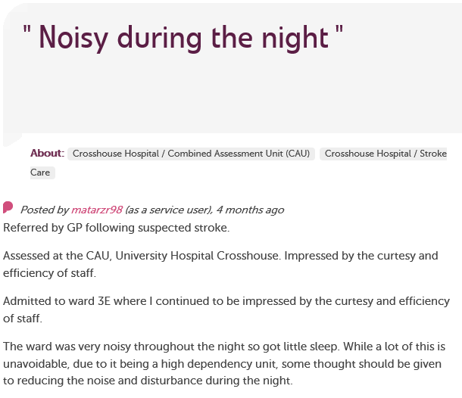
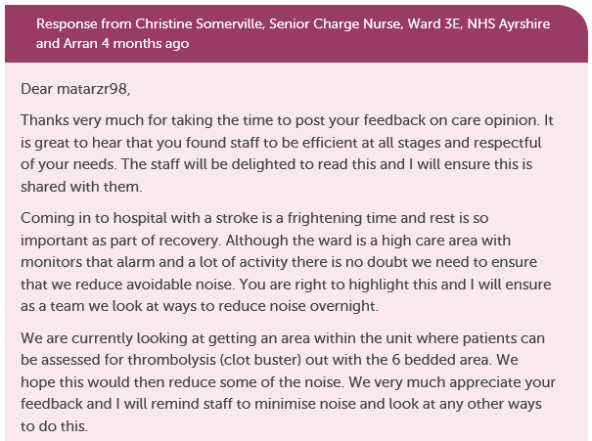
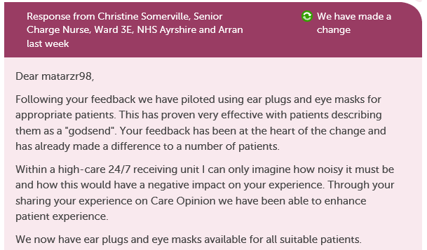

Slide 12
“It was therapeutic in healing my soul.”

Slide 13
“It was a difficult time for me to go through and Care Opinion allowed me to control the speed and words rather than be rushed through Q&As or tick box scenario where things don't quite fit.”

Slide 14
“The fact I did not have to give my name made it a lot easier to provide feedback. I find it hard to do it in person.
I would like it to make changes.”

Slide 15
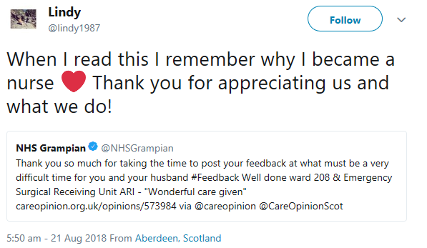

Slide 16
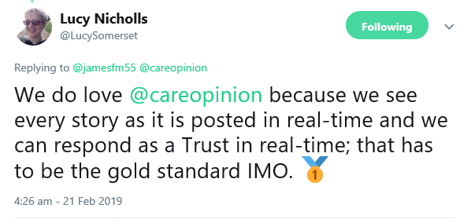

Slide 17
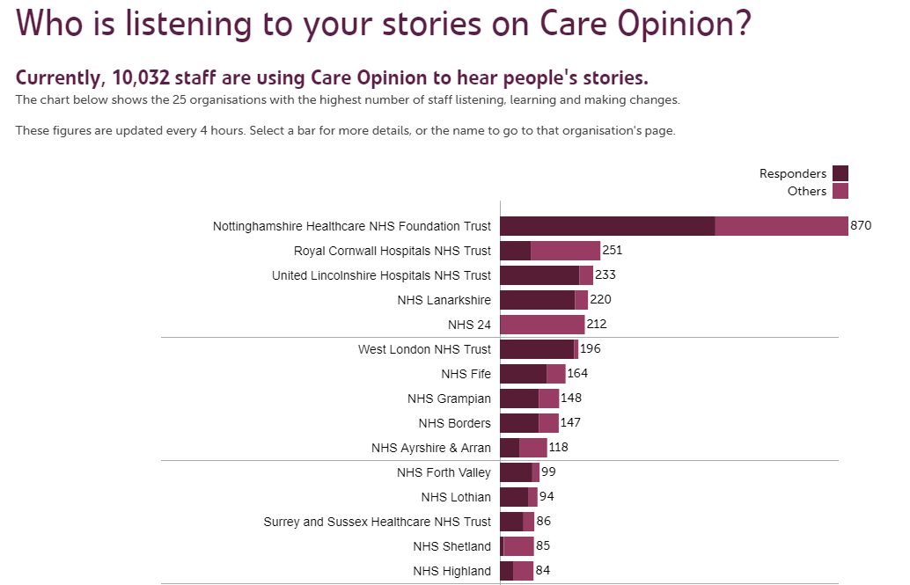

Slide 18
System level impact
“Scotland has now been using Care Opinion for a number of years and we are starting to see real change. Team working, learning, data and transparency are all working together to create something really powerful for our health and social care service.”
Professor Jason Leitch, national clinical
director for the Scottish Government

Slide 19
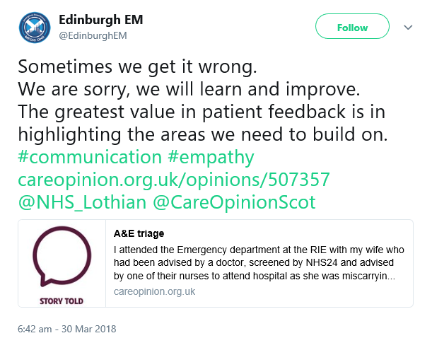

Slide 20
The world is changing – fast
Old world | New world
Hierarchy | Network
Broadcast | Conversation
Hiding | Sharing
Few | Many
Closed | Open
Passive recipients | Active participants

