Slide 1
Fostering a Culture of Openness and Transparency: Our Journey with Care Opinion
Hampshire and Isle of Wight Healthcare Trust
Alex Clements - Physical Health Public Engagement lead
Dr Abigail Barkham – Consultant Practitioner (nurse)

Slide 2
A Growing Movement: Our Journey with Care Opinion
Rapid Expansion:
60 new teams joined the platform in the last 6 months
Consistent monthly submissions of around 70 stories
Addressing Challenges:
Successfully navigated concerns around content moderation and workload
Leveraged Care Opinion's expertise for seamless implementation
Proven Success:
Executive team renewed funding for another year, recognizing the platform's value
Timeline:
Mid-2022: Pilot launch in Mid and North Hampshire (25 teams)
2022-2023: Expanded to 40 teams, with a 2024: Full trust rollout, targeting all 600 teams, 110 currently on board
Key Metrics:
2100+ stories
280,000+ reads

Slide 3
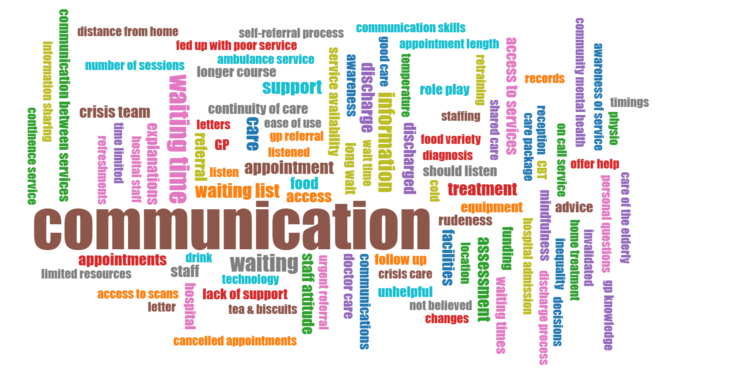
What could be improved - Pre rollout

Slide 4
Culture Change Through Open Communication
After Care Opinion:
Increased openness and honesty:
Staff feel empowered to share feedback and ideas
Open discussions about challenges and successes
Enhanced patient-staff relationships
Improved staff morale and engagement:
Recognition and appreciation for hard work
A sense of belonging and team spirit
Increased job satisfaction
‘ We now know how our patients feel and experience our service’
‘It helps us to understand our service’
‘we've made changes’

Slide 5
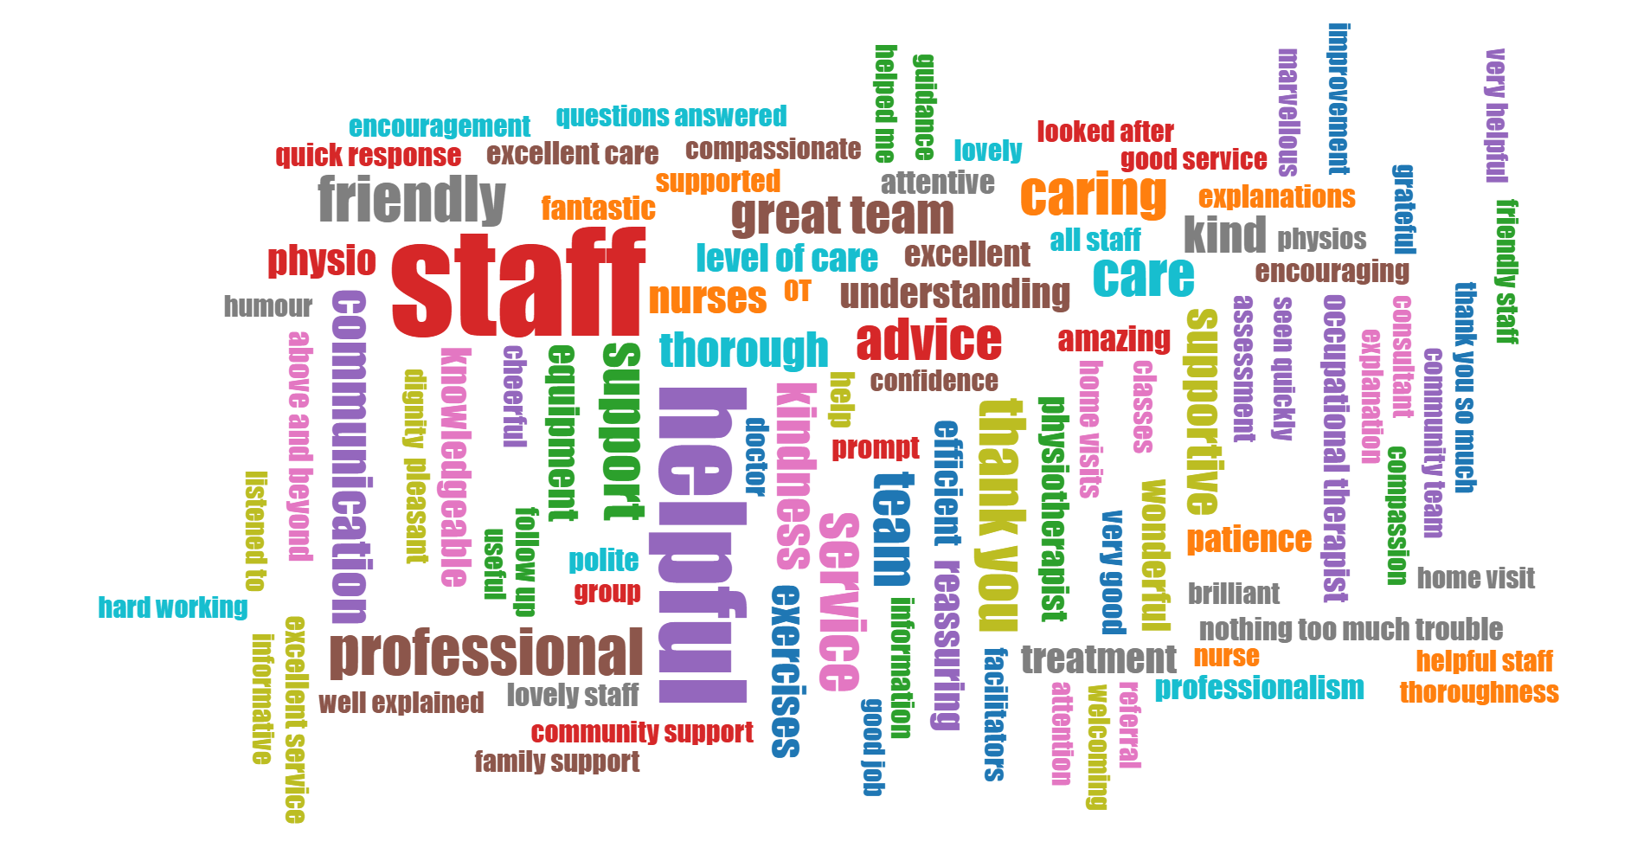
What has gone well - Post rollout

Slide 6
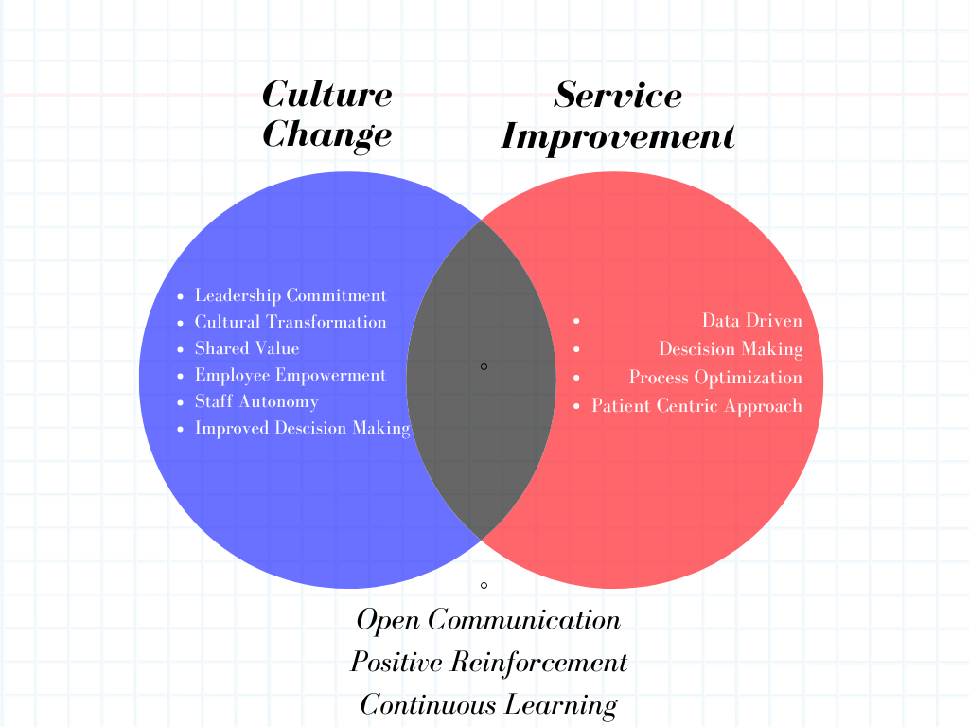

Slide 7
Driving Service Improvement with Real-time Feedback
Case Study: Story 2000
‘My Mum - who is in her 80s - was taken into Basingstoke A&E feeling very unwell with Covid and subsequently pneumonia. She spent 4 nights in ED/AAU and was discharged home with minimal assessment and no ongoing support.
Due to her frailty and Parkinson's, we - her family - struggled to care for her in the days following the discharge. We were very concerned and via the GP were put in the care of the UCR North Hampshire Team.
Our heartfelt thanks to all those who came within hours to assess, observe and care for Mum. We have no doubt that without this intervention and care, Mum would have needed re-admission to hospital, which she certainly did not wish for.
The incredible care received - always respectful, professional and friendly has made an enormous difference to Mum's continuing recovery. As family, we were very reassured to have the Team's support and guidance.
Thanks to Millie, Maria, Mary, Chloe, Debbie, Bev, Chris and Dave - their nursing care, expert physio guidance and tech/aid support was invaluable - the care was above and beyond.’
Real-time Insights:
Immediate feedback on service delivery
Identification of areas for improvement
Celebration of successes and positive feedback
Data-Driven Decision Making:
Informed decision-making based on real-world data
Prioritization of improvement initiatives
Increase in staff level engagementl

Slide 8
A Brighter Future: Scaling Impact Across the Trust
Expected Impact:
Enhanced Patient Experience: Increased patient satisfaction and empowerment through transparent communication and personalized care.
Strengthened Staff Morale: A more engaged and motivated workforce, leading to improved job satisfaction and retention.
Data-Driven Improvement: A culture of continuous learning and improvement, fueled by real-time feedback and data analysis.
Elevated Trust Reputation: A stronger reputation as an innovative and patient-centered healthcare provider.

