Slide 1
The rise and rise of online patient feedback – but how should we be responding?
@Rebecca_Baines_
Rebecca Baines
University of Plymouth
Rebecca.baines@plymouth.ac.uk
@Rebecca_Baines_
John Donovan
Patient research partner
Sam Regan de Bere
University of Plymouth
Julian Archer
University of Plymouth
Ray Jones
University of Plymouth

Slide 2
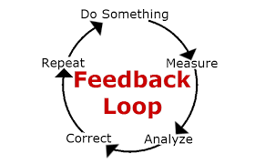
What we know so far…
Patient feedback is regarded as integral to professional development, patient safety and quality of care.
Patients are increasingly sharing their healthcare experiences online.
Importance of a feedback loop.
However…
What makes a good response?
What are patients looking for in a response?
And can organisational responses be improved in any way?

Slide 3
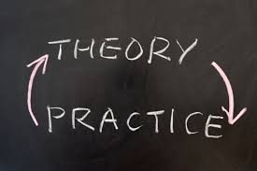
Why is it worth exploring?
John, patient research partner
Evidence suggests receiving a bad feedback response can lead to feelings of frustration and dissatisfaction.
Implications for organisational reputation, public inferences of trust and perceived responsiveness.
Further complaint behaviour.
“patients wish to leave behind a legacy”
“we want to be heard… being heard is an integral part of the healing process”
“providing feedback and being responded to is a way of becoming an equal partner in our NHS – it becomes a way of being ‘us and us’ as opposed to us and them, we’re in it together”

Slide 4
Methodology
Mental health
Acknowledged difficulties in receiving patient feedback and subsequently responding to this community
More likely to maintain contact with medical services if satisfied with their care
Implications for clinical relapse rates, hospital admissions/re-admissions and resource expenditure
Systematic search of stories about adult mental health published on Care Opinion
Inductive thematic analysis of identified stories and responses in collaboration with patient research partner
Refinement and development of initial themes with local service-user group (Heads Count) – co-development of response framework
Resource constraints, only stories and corresponding responses in the South West of England were included.
Quality appraisal of existing responses using co-develop
Further details of the methodology used including search terms can be found at https://onlinelibrary.wiley.com/doi/full/10.1111/hex.12682

Slide 5
What we found
Stage 2: thematic analysis
Stage 1: systematic search
1. Provides a photo of responder | 11. Offers reassurance**
2. Provides responder name | 12. Tailors response
3. Names the story provider in response | 13. Offers to make contact with the story provider at a later date **
4. Identifies responder role | 14. Signposts patient to other relevant services**
5. Provides explanation of responder role | 15. Explains purposes of signposted services and why these have been suggested**
6. Explains why the responder in particular is responding | 16. Provides contact details and a named person for these services**
7. Responds within 7 days | 17. Provides opening times for suggested services**
8. Offers thanks for providing patient story | 18. Suggests more than one contact option**
9. Offers to pass feedback onwards if positive in nature* | 19. Signs off response in a polite manner
10. Provides an apology**
190,345 stories published on Care Opinion - 2386 (1.25%, 2,386/190, 345) were identified as stories about adult mental health services in England. 10.3%, (245/2386) were from the South West.
74.7% (183/245) received a response from 41 different job roles or titles
24 (9.8%) had been heard but not yet responded to.
Only 1.6% (n =4/245) of included responses were tagged by the organization as “may lead to a change.”

Slide 6
Introductions
“It’s hard to forge a trustful relationship with someone without knowing their name” (Participant 3)
“standard good manners” (Participant 1)
Speed of response
Assurances of “we are listening to you” become undone if organisations fail to respond in sufficient time
Tailoring content
“The last thing you appreciate is a standard response, you want to be treated as an individual, given an individual response” (Participant4)
patients are quick to detect “standardised” or “meaningless” responses
“It’s a couldn’t care less response. In my tray and out again, makes you question what’s the point, it’s not going anywhere?” (Participant 5)
“thank you for your automated response” (164520)
Thanks and apologies:
Recognition of time spent providing stories, empowering staff members, boost morale
Pictures
“That’s nice, she’s put a face to a name, nice smile, looks friendly, not like she’s going to jump down your throat in uniform” (Participant 6)
Offering to forward on positive feedback:
“the sole reason behind patients taking the time to provide feedback – it must get back to them, it must make a change, otherwise what’s the point?” (Participant 3)

Slide 7
Stage 3: development, refinement and co-production of response framework
Plymouth Listen, Learn and Respond framework (PLLR)
https://onlinelibrary.wiley.com/doi/full/10.1111/hex.12682

Slide 8
Stage 4: quality appraisal of existing responses
Plymouth Listen, Learn and Respond framework (PLLR)
https://onlinelibrary.wiley.com/doi/full/10.1111/hex.12682

Slide 9
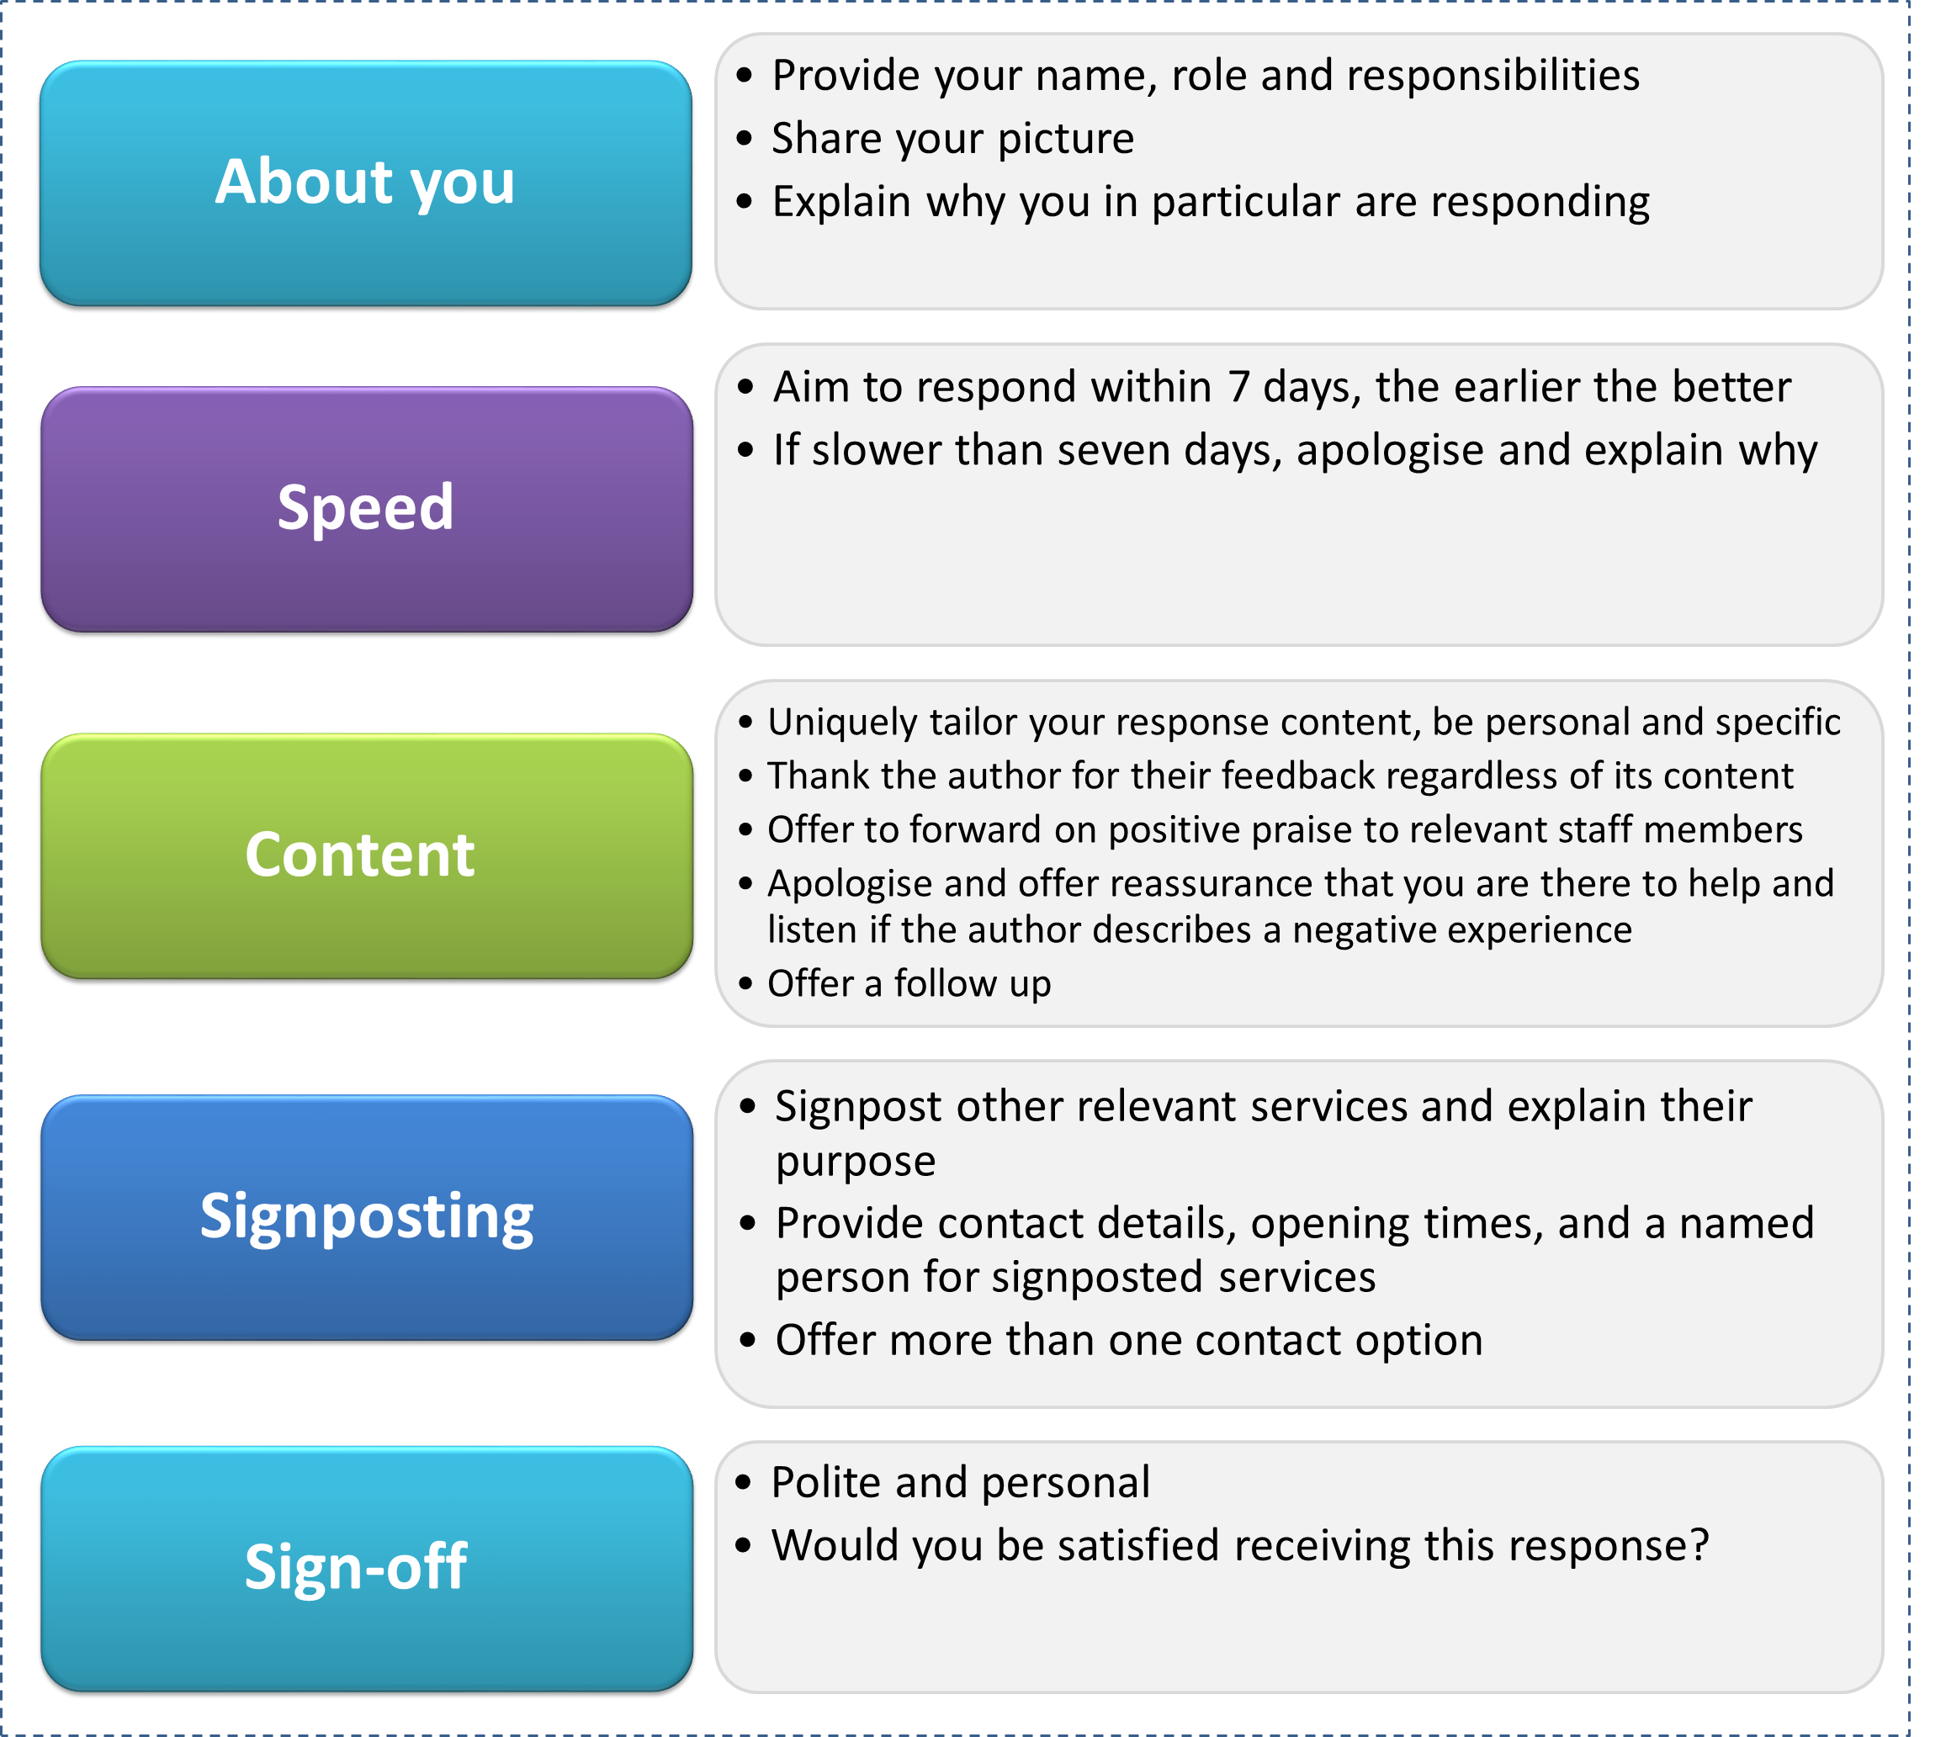
https://www.careopinion.org.uk/blogposts/698/what-do-people-want-in-a-response-to-their-fe

Slide 10
Discussion
Responding to patient feedback is an important and valuable part of care.
The use of social media to share healthcare experiences is unlikely to disappear. We need to ensure we are listening and responding well. We can learn so much from patient experience– let’s allow ourselves to have those conversation.
Patients share their feedback online to improve services, praise staff members and prevent service failure for others. These may be important motivators in trying to encourage feedback engagement.
Time – responding to patient feedback does take time. But so does providing patient feedback and conforming to complaint procedures…. What are the costs of ignoring such information? Coulter et al., argues to ignore patient experience data when asked, is unethical.
We have a duty to listen, learn, and respond. It could give us a sense of renewed enthusiasm and motivation. It might also just teach us something new….

