Slide 1
How do we maximise the impacts of online feedback?
James Munro, CEO, Care Opinion CIC

Slide 2
The world is changing – fast
Old world | New world
Hierarchy | Network
Broadcast | Conversation
Hiding | Sharing
Few | Many
Closed | Open
Passive recipients | Active participants

Slide 3
System level impact
“Scotland has now been using Care Opinion for a number of years and we are starting to see real change. Team working, learning, data and transparency are all working together to create something really powerful for our health and social care service.”
Professor Jason Leitch, national clinical
director for the Scottish Government

Slide 4
Are we there yet?

Slide 5
Sheffield: EURIPIDES study, 2019
Context | Mechanism | Outcome
When patients are unwell, communicating their experiences in a way that staff respond and listen to can be difficult | Patients feel staff don’t listen to what they say. Patients report being discouraged from sharing their experiences. Patients feel isolated and unsupported. Patients less likely to give honest feedback. Patients aware of informal rules about what can & can’t be discussed. Patients share less about their experiences. | Patients do not feel they can explain or raise their concerns about their experiences and so do not engage in giving honest feedback

Slide 6
Increasing the impact of feedback
Impact
Education
Revalidation
Research
QI
PPI
Regulation

Slide 9
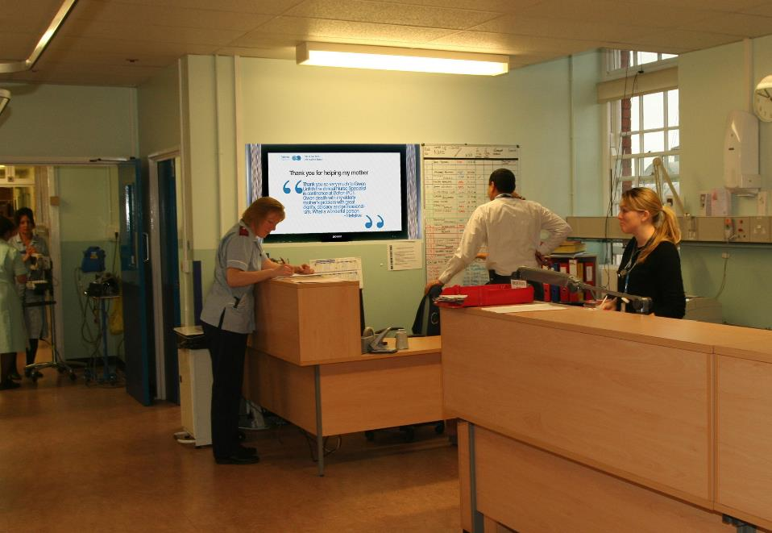

Slide 10
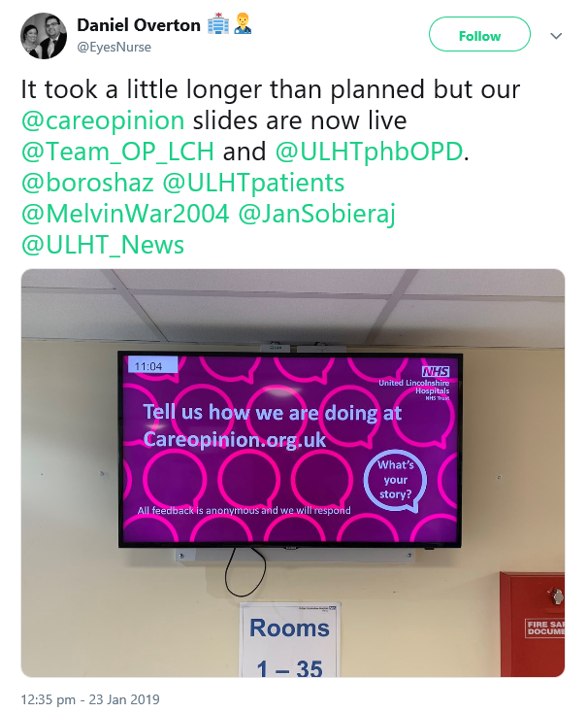

Slide 11
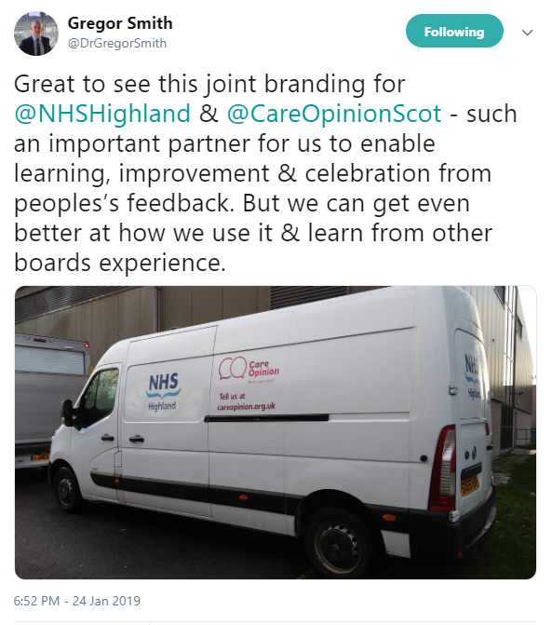

Slide 12
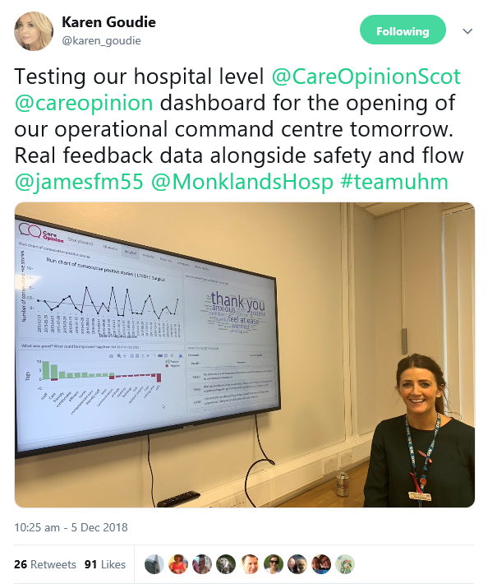

Slide 13
Real-time iHub QI study
Online feedback via Care Opinion
Structured conversations with people about their experiences of care
Care team discusses and agrees improvement opportunities
Report on progress via Care Opinion
Test and evaluate improvements
Implement and spread improvements

Slide 14
“We’re often told the NHS must be patient-centred.
Care Opinion helps us understand what that means in practice.”
Fiona Tevendale
Student nurse
Edinburgh

Slide 15
Learning from online stories
patient experience
person-centred care
communication
empathy and compassion
ethics
quality improvement
leadership
responding to complaints
inter-professional learning
digital professionalism

Slide 16
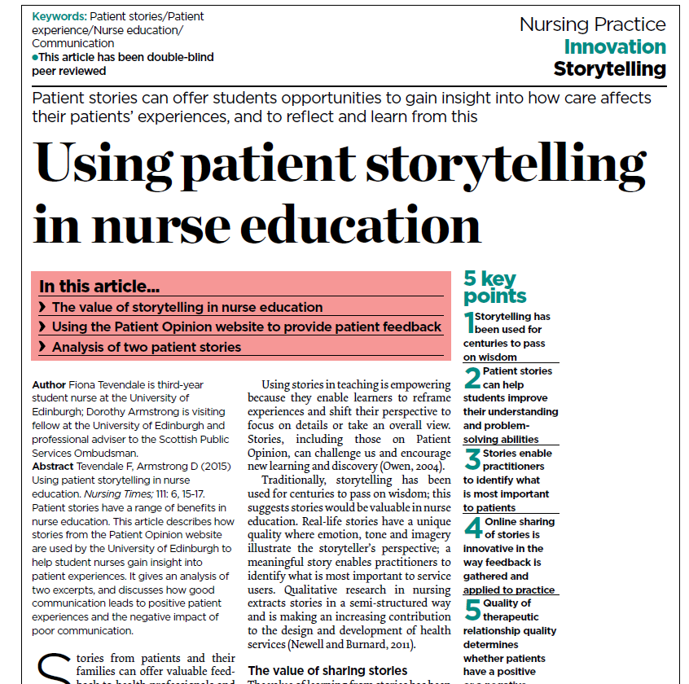

Slide 17
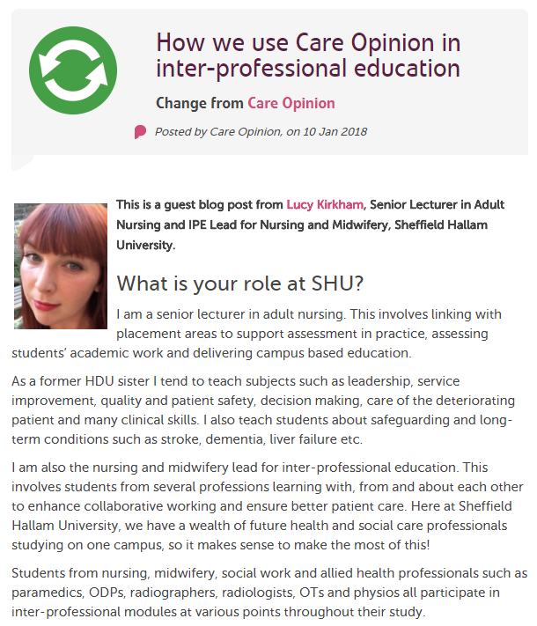

Slide 18
New tools for online learning

Slide 19
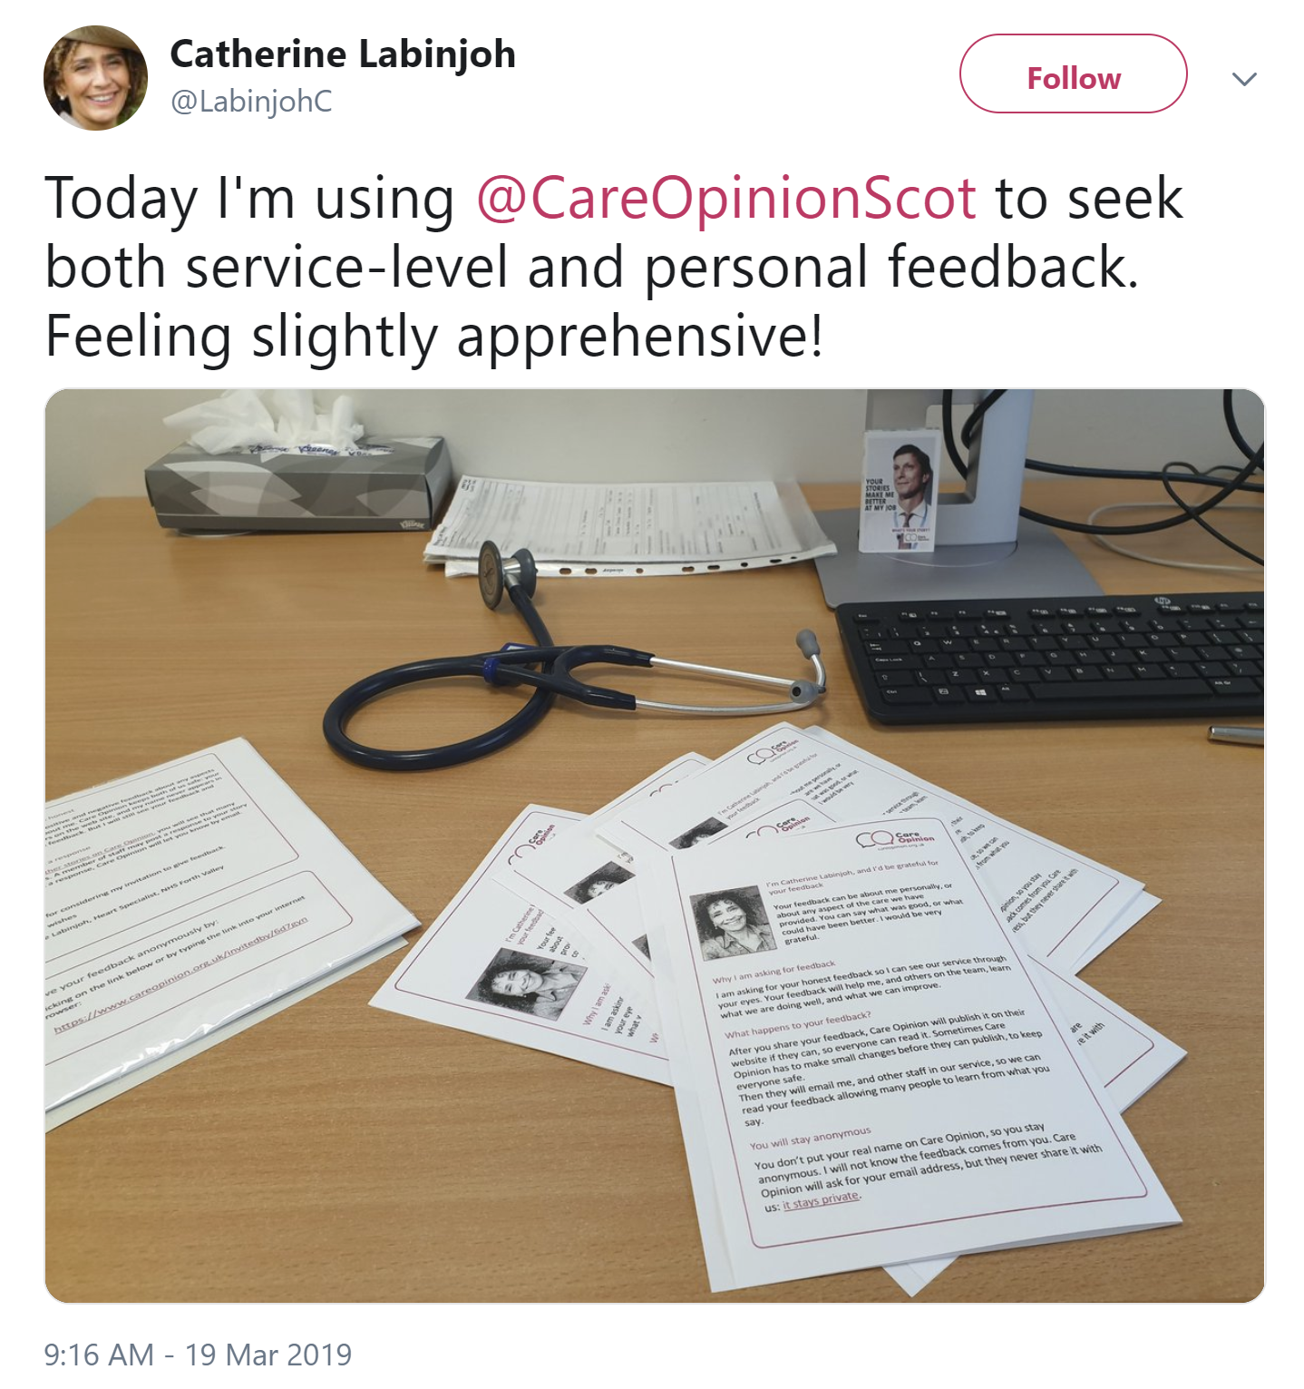

Slide 20
Hear the patient voice at every level – even when that voice is a whisper.
Don Berwick
August 2013

