Slide 1
A few small steps for Nottinghamshire Healthcare A Giant Leap for Forensic Mental Health Services
5 No 1’s

Slide 2
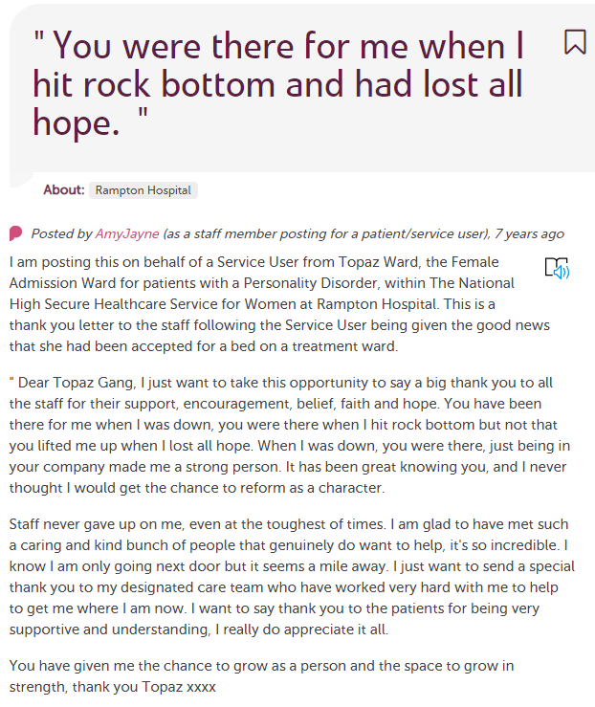
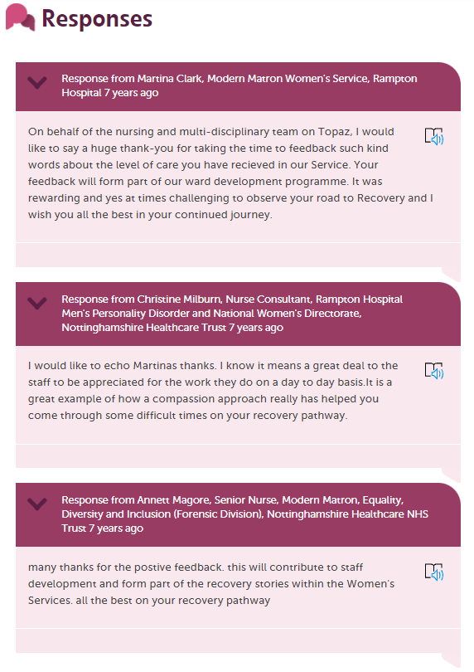
No 1 First NHS Trust with stories from patients in a high secure hospital
One of our early stories from a patient in Rampton Hospital. December 2013. Captured by the Involvement, Experience & Volunteering team. www.careopinion.org.uk/124560 and now?
492 published stories
from Rampton patients

Slide 3
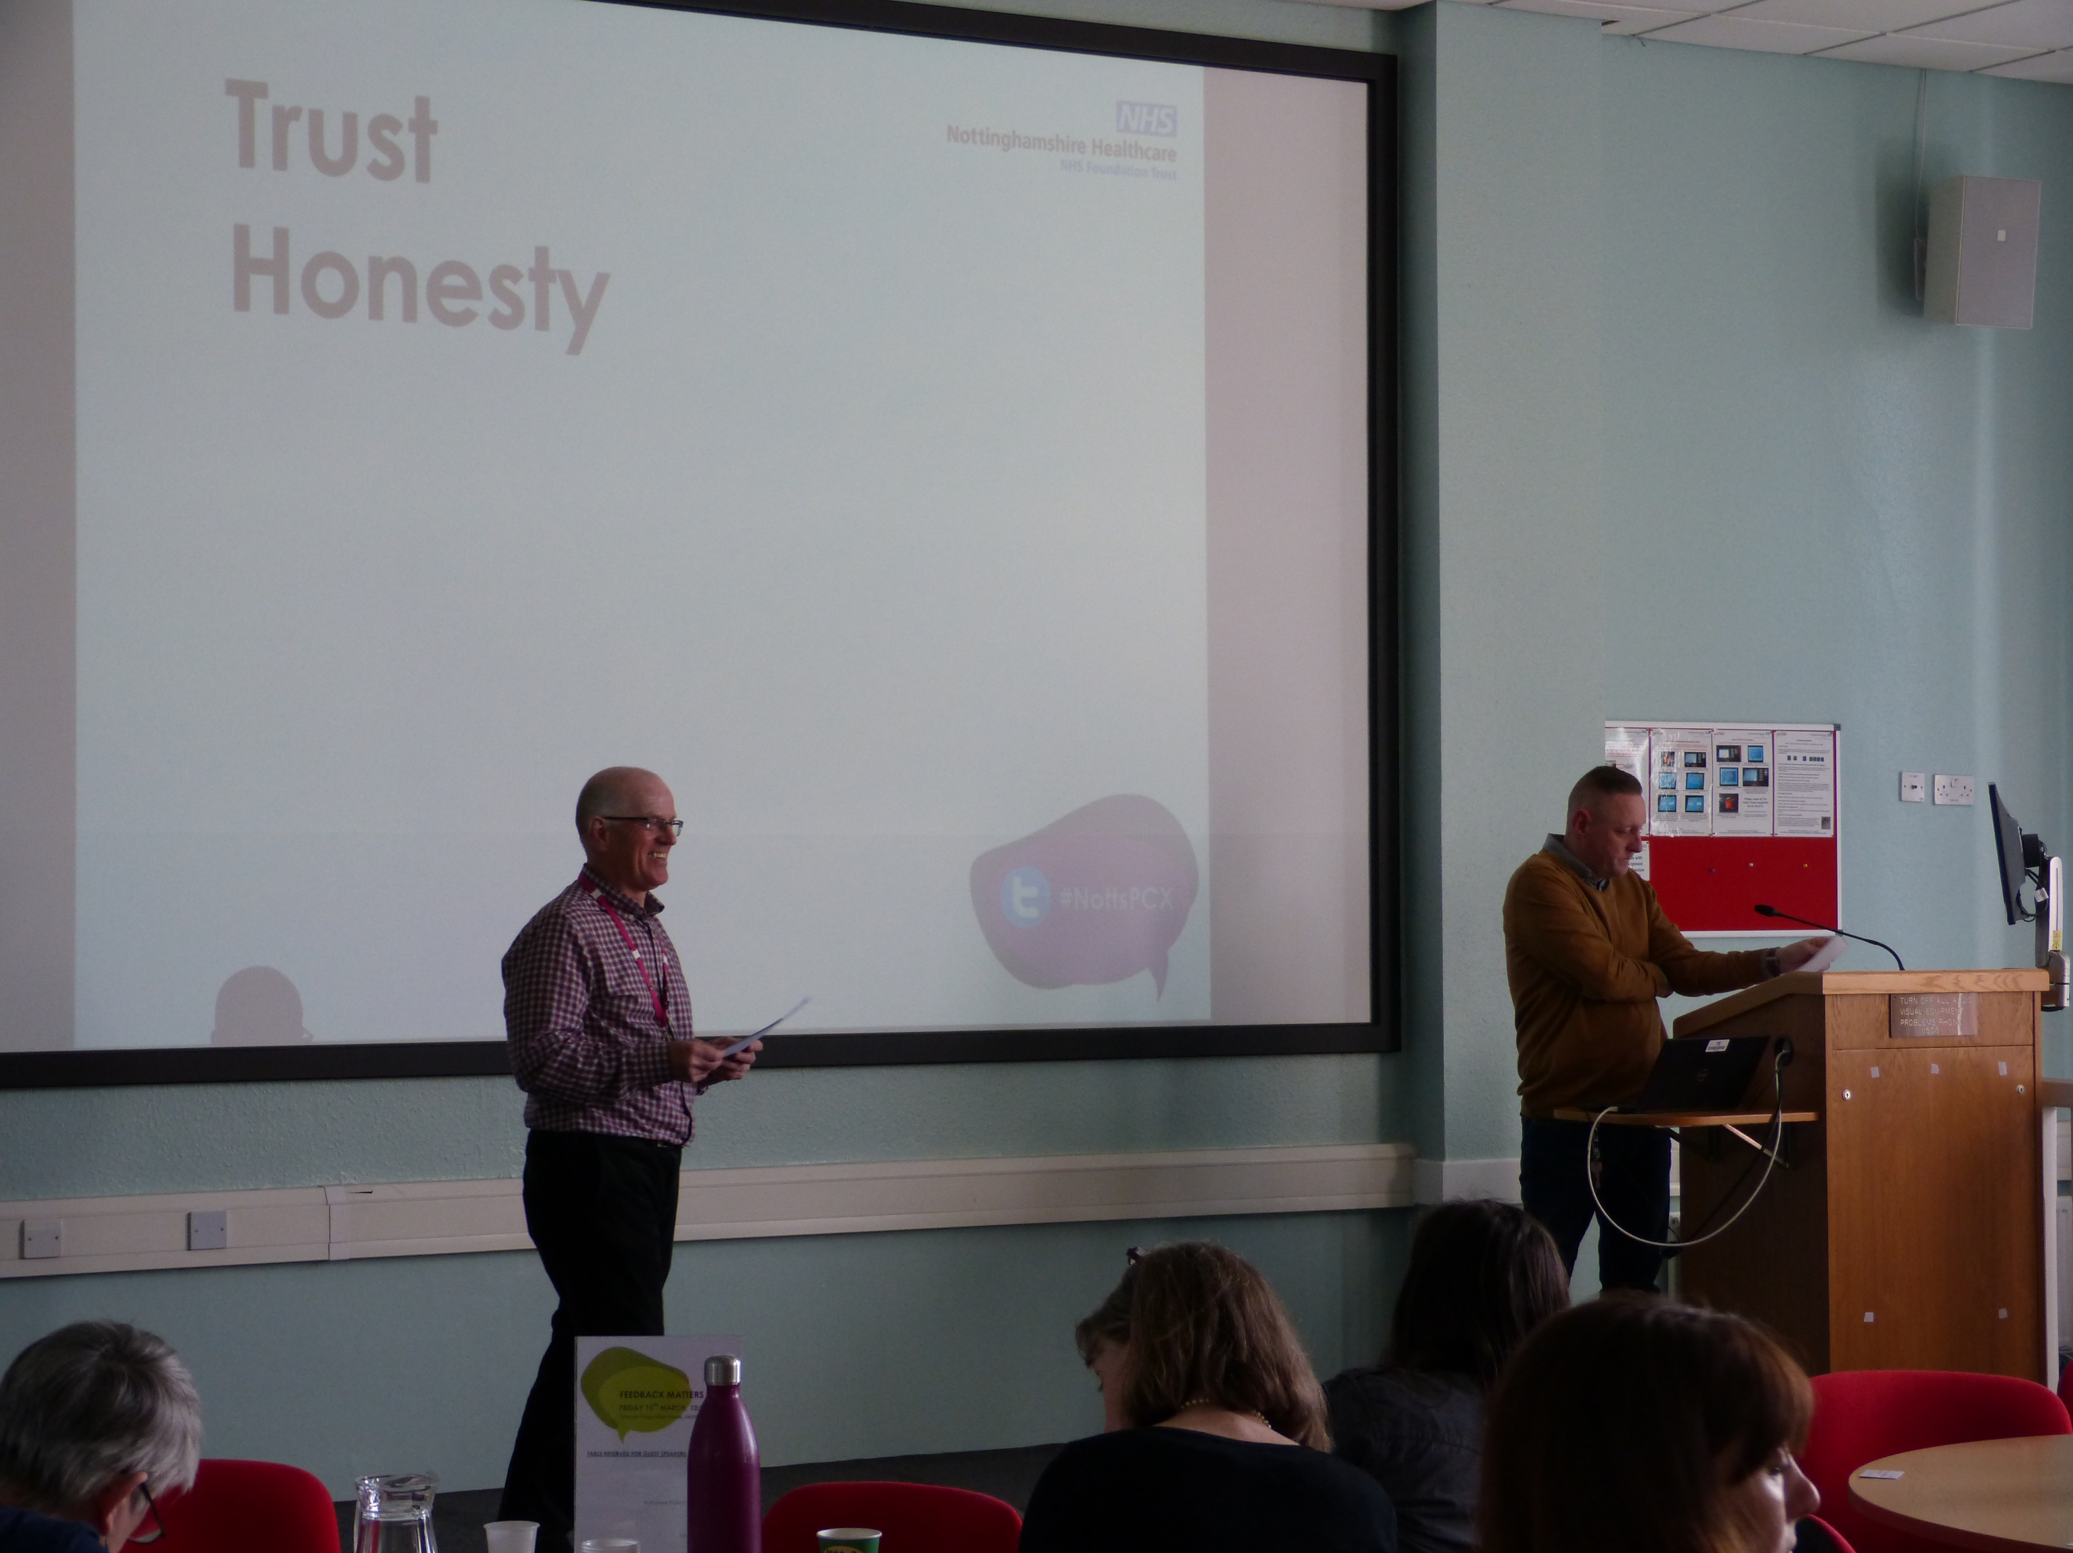
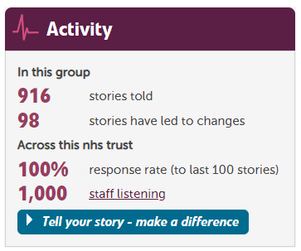
No 2 First NHS Trust to recruit volunteers to collect Care Opinion stories. (not just our Forensic Services) Volunteers are recruited to collect feedback via CO leaflets and kiosk links on tablets/laptops. 65 stories about Forensic Services attributed to a volunteer as an author Of the 916 stories about our Forensic Mental Health services, many were captured by a volunteer but attributed to a patient, with their email address.
Feedback volunteers in Forensic Services presenting to staff about their roles.

Slide 4
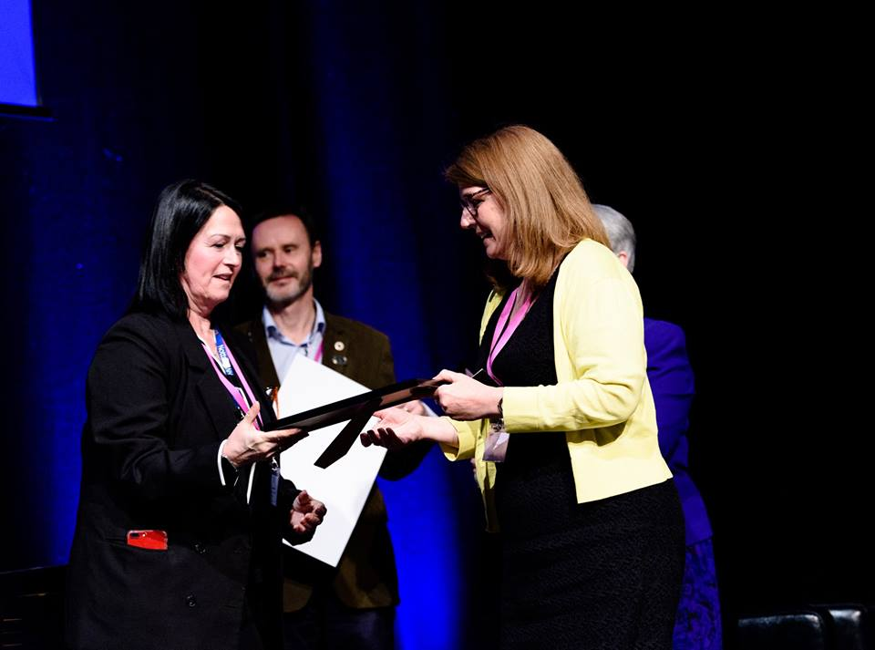
No 3 First time Care Opinion feedback featured in Patient Forum feedback action plans Now rolled out across the Forensic Division Nottinghamshire Healthcare Trust
No 4 First time a patient in seclusion was able to give feedback via Care Opinion
Our approach led to an award in the Patient Experience Network Awards in 2019 (pictured: Kath Alder, Rampton Hospital)

Slide 5
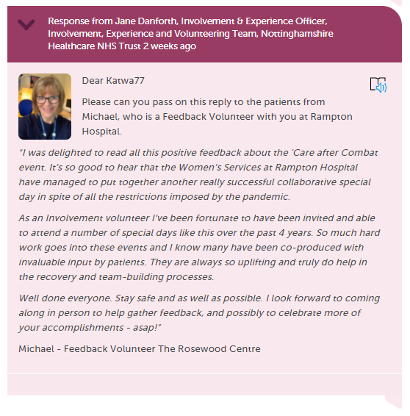
We are exploring the value and practicalities of volunteers responding to postings on behalf of the Trust. They are already integrated into our approach to capturing and responding to feedback from patients, not just in Forensic Mental Health services but right across Notts. Healthcare. Volunteers in Action at Rampton Hospital www.careopinion.org.uk/blogposts/622/volunteers-in-action-at-rampton-hospital
No 5 First time a volunteer responded on behalf of an NHS Trust

Slide 6
5 No 1’s
1 First NHS Trust to publish patient stories from a high secure hospital.
2 First NHS Trust to recruit volunteers to collect Care Opinion stories. (not just our Forensic Services).
3 First time Care Opinion stories featured in patient forum feedback action plans.(This is now rolled out across the division).
4 First time a patient in seclusion was able to give feedback.
5 First time a volunteer responded on behalf of an NHS Trust.
See the latest change from Rampton Hospital - 38 in total
www.careopinion.org.uk/878180

Slide 7
Tell us how we are doing at Notts Healthcare
www.careopinion.org.uk/services/rha
What’s your
Story?
https://involve.nottshc.nhs.uk/blog/experience/
All feedback is Anonymous. We respond to all stories

