Slide 1
Care Opinion
The wizards
behind the
curtain

Slide 2
What is Moderation?
Authors submit stories about a health or social care experience.
Moderators check and edit stories before publication.
Identifying safeguarding concerns
Examples of edits we might make:
Anonymising
Tagging services
Metadata

Slide 3
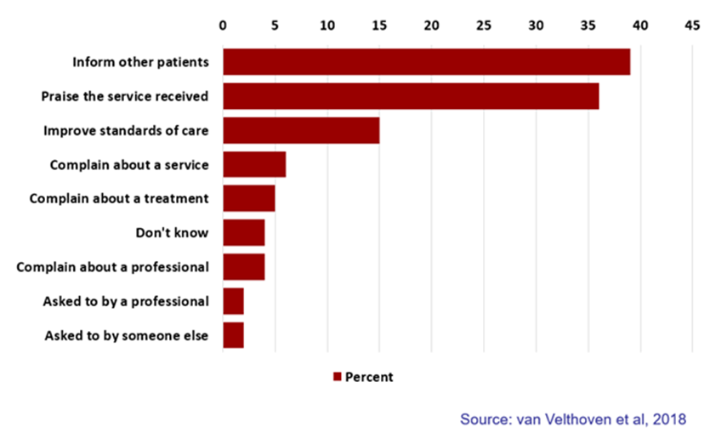
Why people post feedback online

Slide 4
Why we moderate
We have four aims which guide our moderation on Care Opinion
Enable a clear, timely, public, constructive conversation about care
Make giving feedback safe and easy for patients, service users and carers
Encourage authentic feedback, based in personal experience
Treat staff legally and fairly

Slide 5
How we moderate
We moderate in line with our moderation policy
Informed by the Care Opinion values
Updating and refining the policy
Maintaining story integrity
Light-touch edits
Author consent
Managing complex stories
Shared decision making
Safeguarding
Contacting authors or services

Slide 6
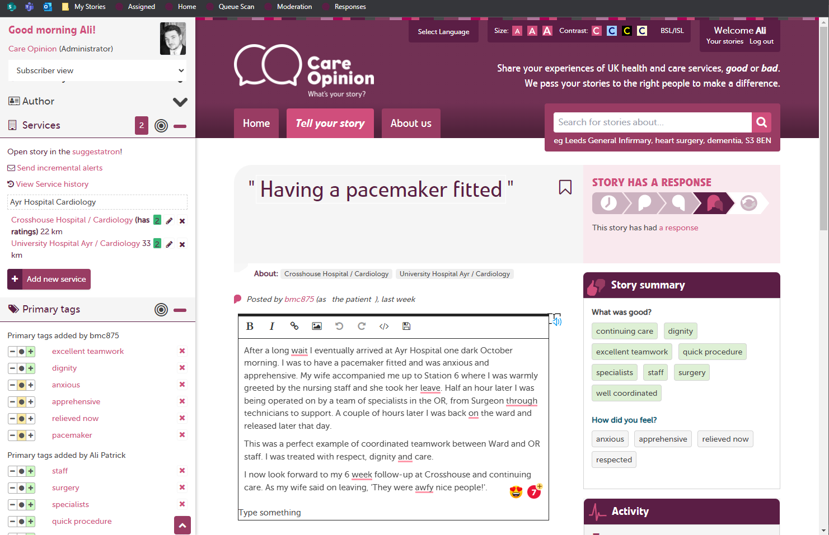
Anatomy of a story

Slide 7
Who moderates
The moderation team
Dedicated 1st line moderators
2nd line moderators
Subscriber support team
Training new moderators
Site training
Safeguarding training
Mentoring, coaching and shadowing
Initial audit

Slide 8
How we maintain quality
Moderation policy constantly reviewed as part of Quality Management System
Monthly moderation meetings for all moderation staff
Quarterly moderation meetings for senior moderators
Robust induction for new moderators
Regular quality audits for all moderators
Adheres to legal advice

Slide 9
Criticality and safeguarding
Criticality assigned to each story
Ratings useful for quality, risk and complaints
Robust Safeguarding processes at both levels of moderation
Process in place for rare safeguarding postings requiring contact with providers

Slide 10
Contact with authors and services
Authors emailed regularly re Tagging to Services etc
Authors sent signposting where necessary, particularly where ongoing issues
Services contacted for critical postings and for safeguarding
Advanced Moderation for Primary Care and specific providers

Slide 11
What matters most in moderation

Slide 12
Questions

Slide 13
Thank you

